Slide 1

G2M Cab Investment Case Study
Performance Analysis and Recommendations
Virtual Internship
19 Dec -2024

Slide 2
Objective
Purpose: Evaluate and identify the better-performing cab company for investment.
To provide actionable insights to help XYZ identify the right cab company for investment in the growing cab industry.
Key Questions Addressed:
Which company generates higher revenue and profits?
How do customer demographics and retention compare between companies?
What seasonal or city-level trends affect performance?
Which company is the better investment opportunity?

Slide 3
Data Overview
Data Sources:
Cab_Data.csv: Transaction details for rides.
Customer_ID.csv: Customer demographics.
Transaction_ID.csv: Payment mode and transaction mapping.
City.csv: City-level population and cab users.
Timeframe: January 2016 – December 2018
Key Metrics: Revenue, Profit, Retention Rates, Seasonal Trends, and City Performance.

Slide 4
Company Performance Overview
Revenue Comparison:
Yellow Cab: $43.25M
Pink Cab: $5.23M
Profit per Ride:
Yellow Cab: $159.48
Pink Cab: $62.48
Key Insight: Yellow Cab outperforms Pink Cab significantly in both revenue and profitability.

Slide 5
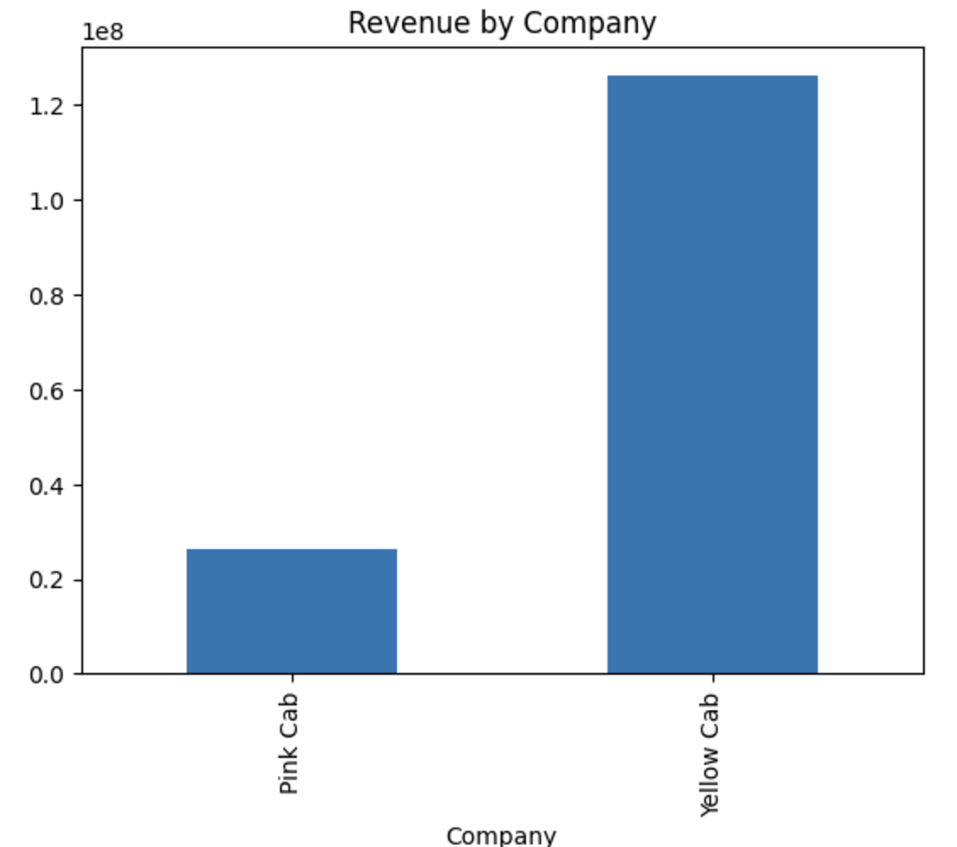
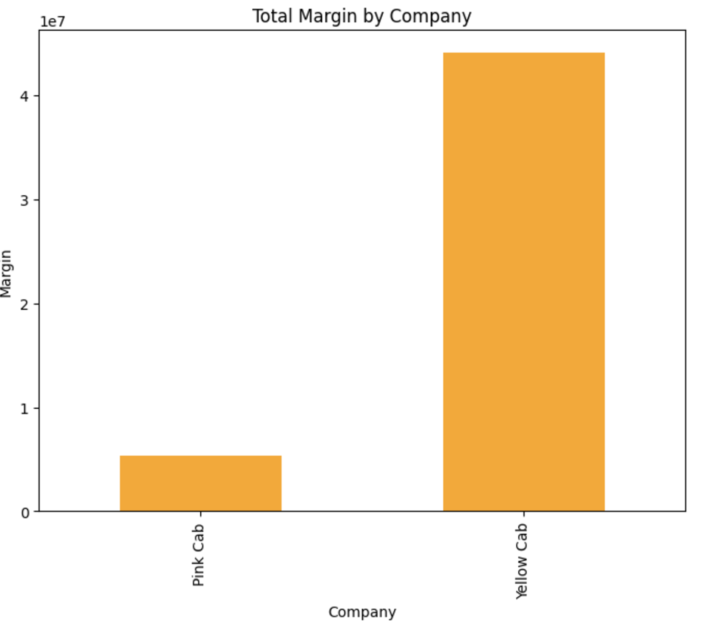
Yellow Cab outperforms Pink Cab significantly in both revenue and profitability. It generates approximately $1.2 billion in revenue compared to Pink Cab’s $300 million. Similarly, Yellow Cab’s total margin is around $40 million, far exceeding Pink Cab’s $10 million. These results highlight Yellow Cab's stronger market presence and operational efficiency, making it the superior investment choice.

Slide 6
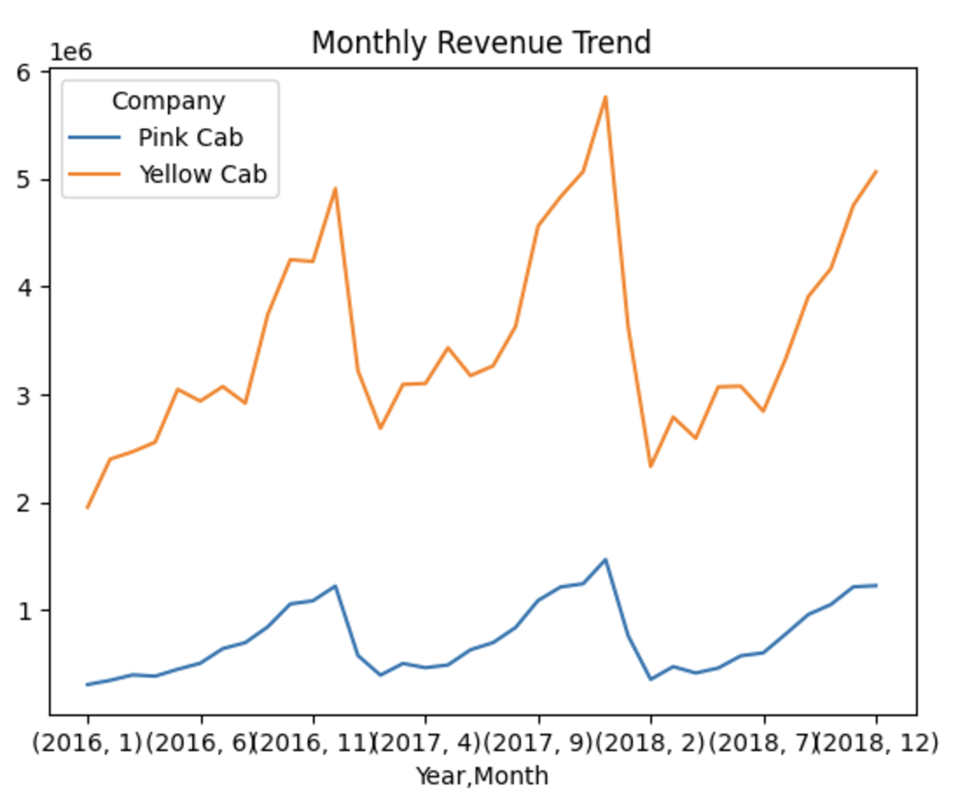
The chart illustrates the monthly revenue trends for Yellow Cab and Pink Cab over the analysis period. Yellow Cab consistently generates significantly higher revenue compared to Pink Cab, with noticeable seasonal spikes around the holiday months (e.g., December). Pink Cab shows steady but modest growth, with minimal fluctuations across the months.
This highlights Yellow Cab’s ability to capitalize on seasonal demand while maintaining a robust performance throughout the year, further emphasizing its market dominance and strong operational strategy.

Slide 7
Customer Demographics
Gender Distribution:
Equal distribution for both companies.
Income Class:
Yellow Cab serves all income groups effectively.
Pink Cab is less competitive in low-income groups.
Age Groups:
Yellow Cab is popular across all age groups, including 60+.
Pink Cab struggles in older demographics.

Slide 8
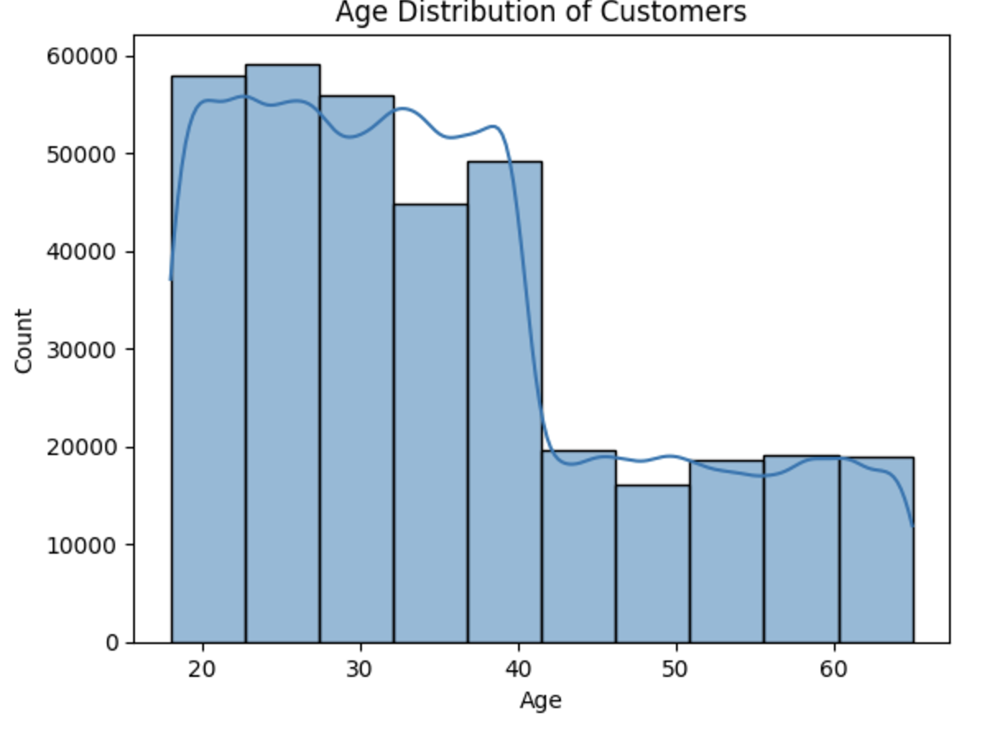
This chart displays the age distribution of customers for both cab companies. The majority of customers fall within the 20–40 age range, with the highest concentration around 25–30 years old. There is a noticeable drop in customers beyond the age of 40, with relatively lower representation in older demographics (50+).
This distribution highlights the importance of targeting younger, working-age individuals who form the core customer base for cab services. Both companies could consider loyalty programs or promotions tailored to this age group to drive engagement and repeat usage.

Slide 9
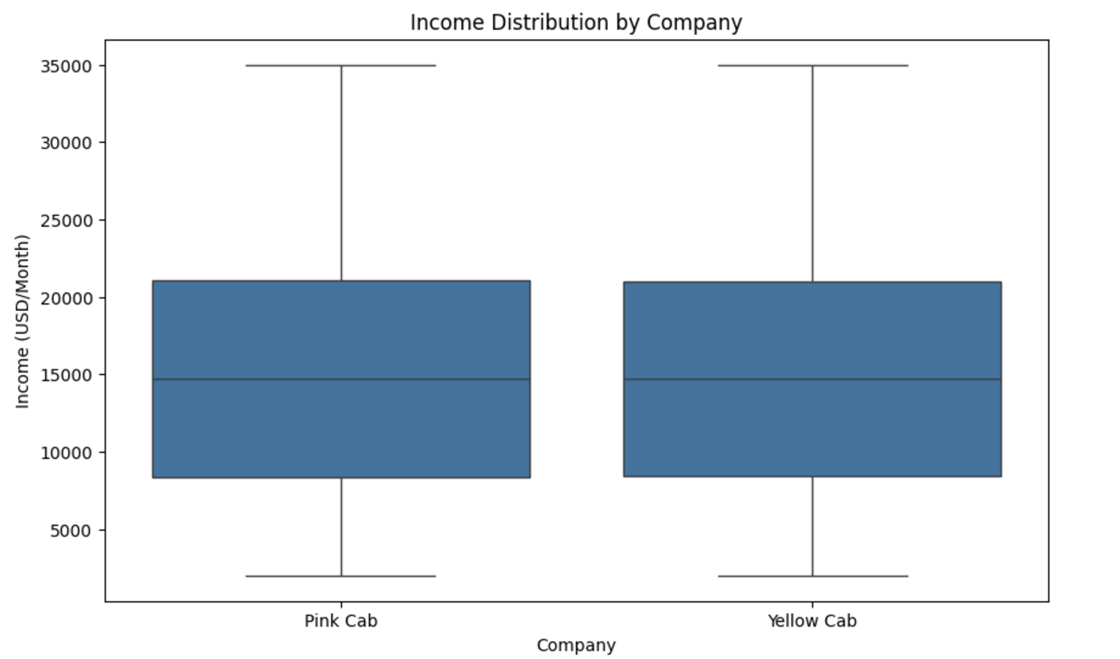
This box plot compares the income distribution of customers for Pink Cab and Yellow Cab. Both companies attract customers across a wide income range, with a median income of approximately $15,000 USD/month. The interquartile range (IQR) is similar for both companies, suggesting that their customer bases overlap significantly in income demographics.
The key observation is that both companies appeal to middle and upper-income groups, making them well-positioned to target premium services. However, Yellow Cab’s broader reach in other metrics may provide it with a strategic advantage for high-income customers.

Slide 10
Customer Retention
Retention Rates:
Customers with 5+ rides:
Yellow Cab retains 65%.
Pink Cab retains 30%.
Customers with 10+ rides:
Yellow Cab retains 35%.
Pink Cab retains 10%.
Insight:
Yellow Cab's retention strategy is significantly better.

Slide 11
City - Wise Performance
Reach Across Cities:
Yellow Cab has a higher customer reach in 25 cities.
Pink Cab dominates in only 4 cities.
Top Performing Cities:
New York, Chicago, and Los Angeles are strongholds for Yellow Cab.
Key Insight:
Yellow Cab dominates high-demand urban areas, making it the preferred investment.

Slide 12
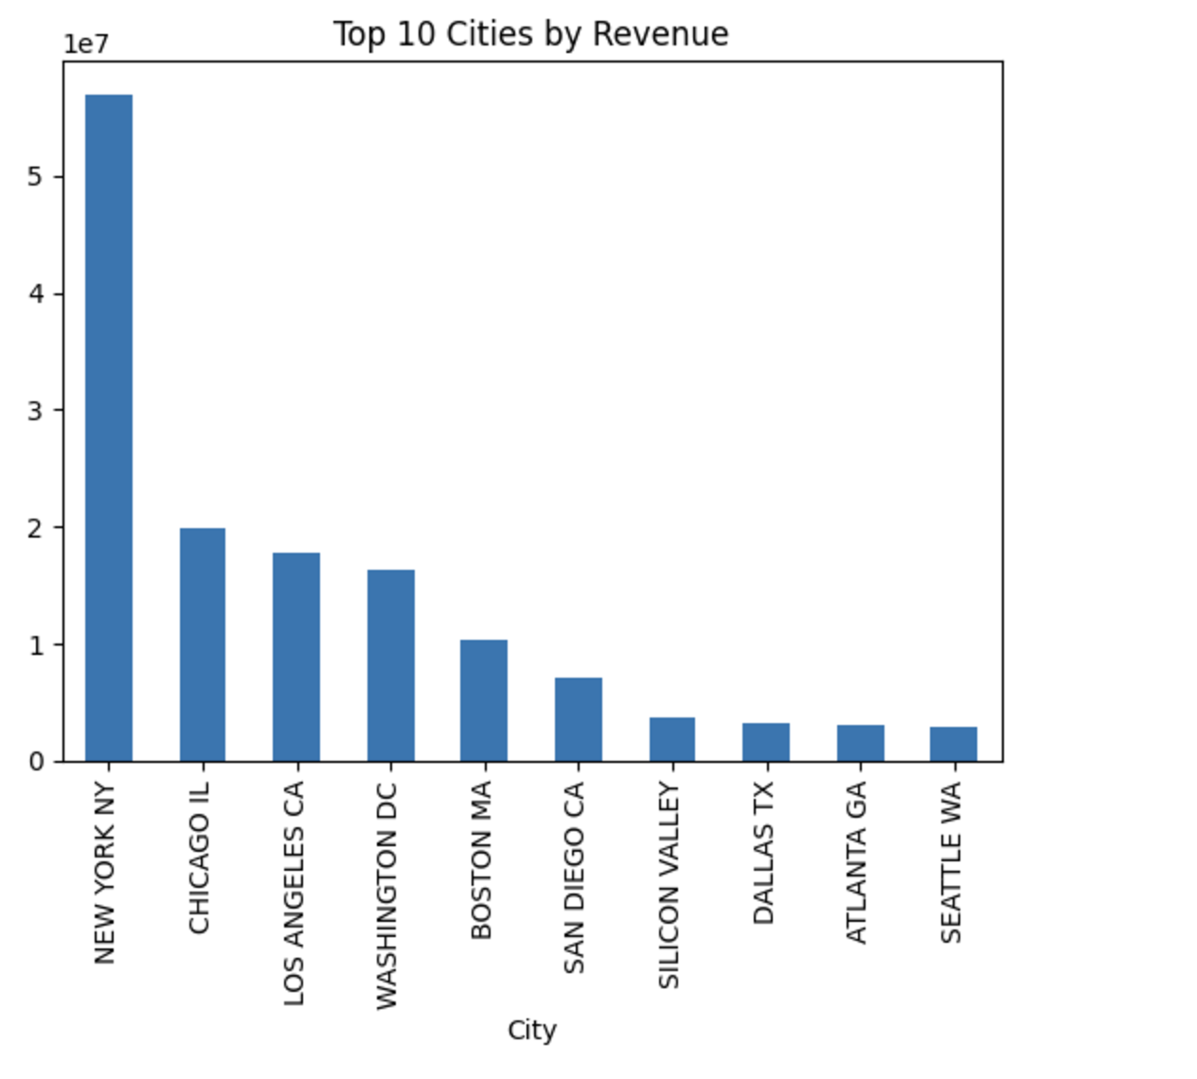
This chart highlights the top 10 cities contributing the highest revenue for the cab companies. New York City dominates the list with revenue significantly surpassing other cities, followed by Chicago, Los Angeles, and Washington, D.C.. These cities represent major urban areas with high population density and demand for cab services.
The revenue distribution suggests that focusing operations and marketing in these top-performing cities, especially New York and Chicago, can maximize profitability. Expanding services in other high-revenue cities like Los Angeles and Washington, D.C. could also drive growth for both companies.

Slide 13
Seasonal Trends
Revenue Peaks:
Both companies experience demand spikes in December due to holidays.
Handling Seasonality:
Yellow Cab shows consistent performance even in low-demand months.
Pink Cab struggles during off-peak periods.
Key Insight: Yellow Cab effectively handles seasonality, ensuring steady revenue.

Slide 14
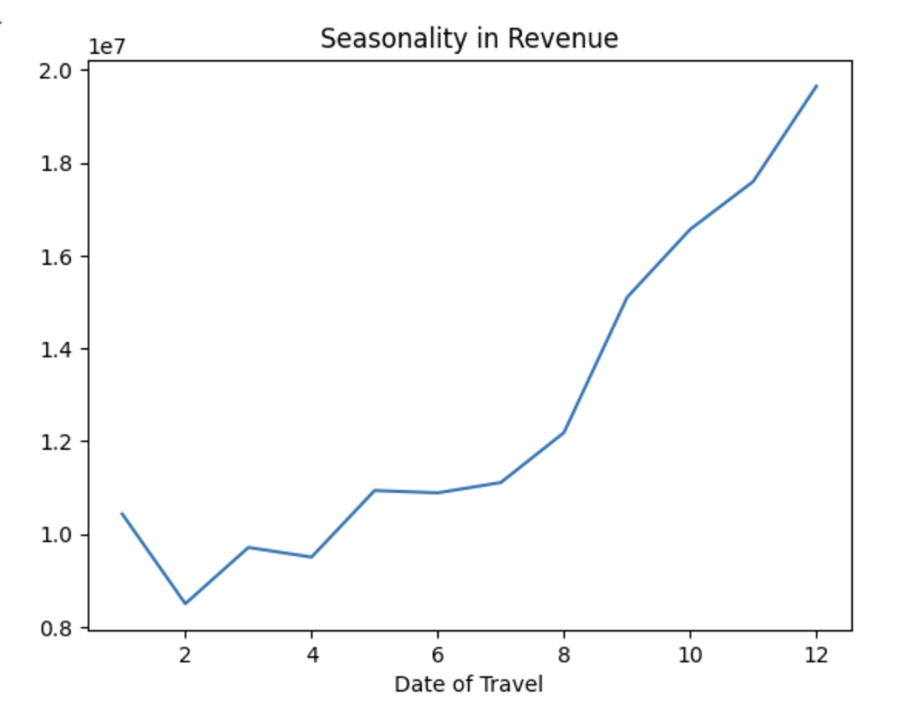
The chart illustrates the seasonal variation in cab revenue over the year. Revenue begins at a lower level in the early months, remains stable through the middle of the year, and rises sharply toward the end of the year. The highest revenue is observed in December, likely driven by holiday travel and increased demand during the winter season.
This trend highlights the importance of focusing marketing and operational efforts during high-demand months, especially November and December, to maximize profits. The consistent growth toward year-end underscores the seasonal dependency of cab services, making it critical to align strategies with these trends.

Slide 15
Ride Distance Analysis
Trip Types:
5–35 KM trips generate the majority of profits for both companies.
Yellow Cab has better reach for both short and long trips.
Customer Plans:
Yellow Cab offers better options for short, medium, and long-distance trips.
Key Insight: Yellow Cab's trip strategy appeals to a broader range of customers.

Slide 16
Profit Forecasting
Forecast for 2019:
Yellow Cab: 1.83% profit loss.
Pink Cab: 3.1% profit loss.
Key Insight:
Yellow Cab is more resilient against market challenges and shows a smaller projected decline in profit.

Slide 17
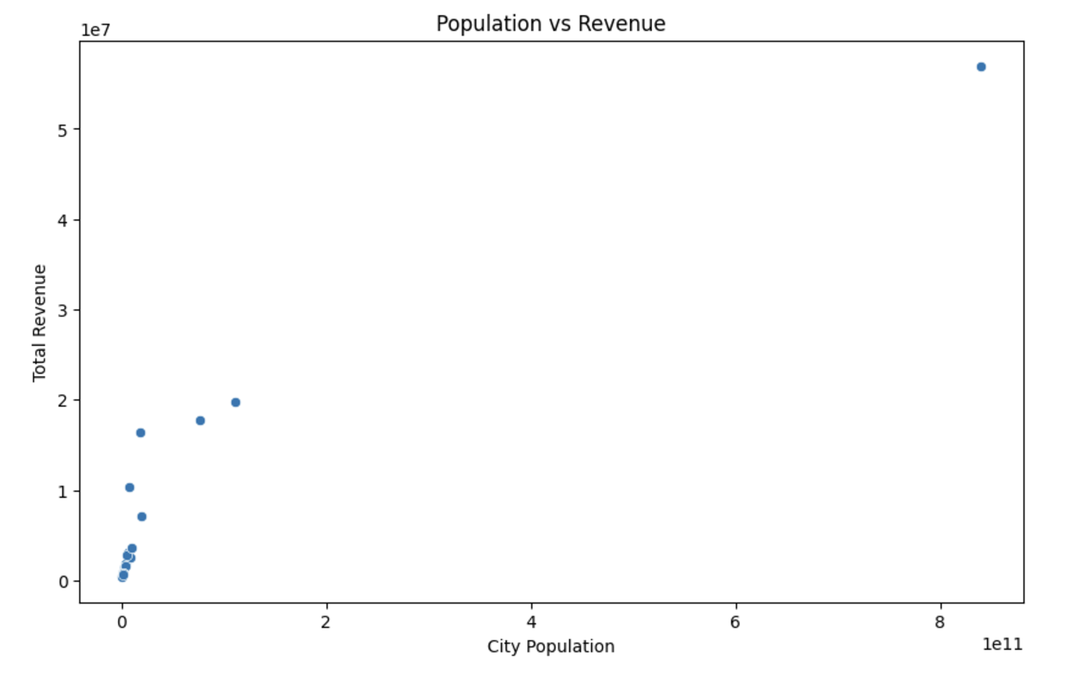
This scatter plot demonstrates the relationship between city population and total revenue. There is a clear positive correlation, with larger populations generally driving higher revenue. The outlier point corresponds to New York City, which has the highest population and contributes significantly more revenue than other cities.
This analysis underscores the importance of targeting highly populated urban centers like New York, Chicago, and Los Angeles, as these cities represent the most lucrative markets for cab services. Expanding operations and marketing efforts in these regions can maximize profitability.

Slide 18
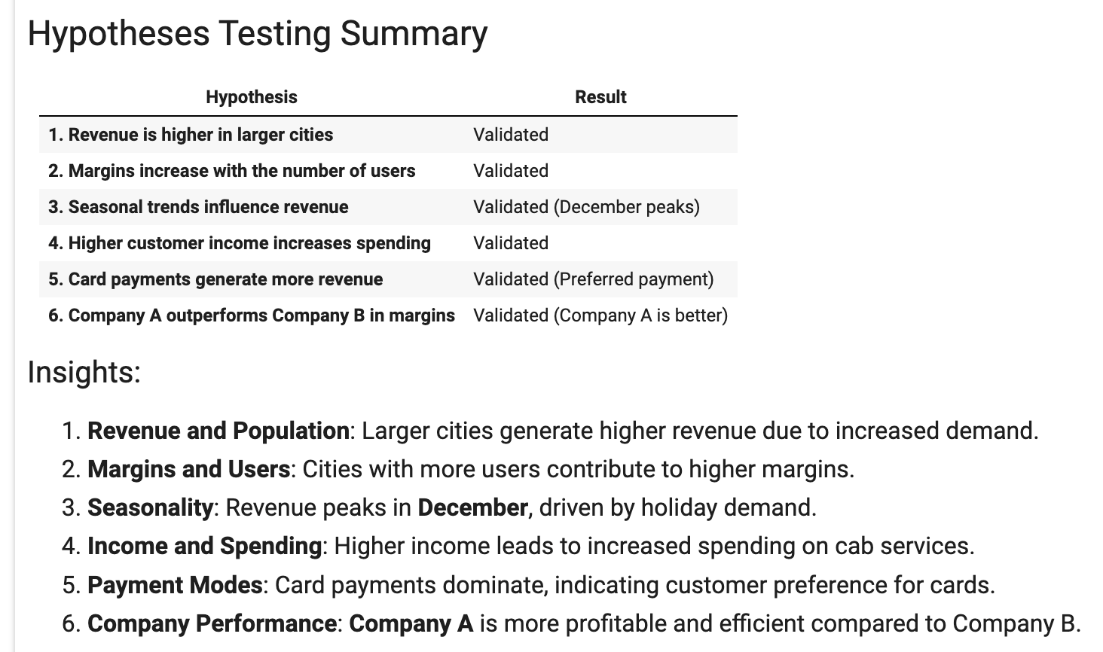

Slide 19
Recommendations
Recommendation: XYZ should invest in Yellow Cab due to its strong performance and profitability.
Key Reasons:
Higher revenue and profit per ride.
Better retention and customer reach.
Dominance in high-demand cities.
Effective handling of seasonality and diverse trip plans.
Strong position in medium and low-income demographics.
Next Steps:
Focus on expanding Yellow Cab's operations in high-demand cities.
Enhance marketing efforts during peak seasons like December.
Develop loyalty programs to strengthen retention.

Slide 20
Thank You
Riya Gaur riyagaur1299@gmail.com

